Slide 1
Operating system Lecture five part1
Dr jamal altuwaijari

Slide 2
5. Process Management
Early C/S allowed only one program to be executed at a time. This program had complete control of the system and had access to all of the system's resources. Today C/S allow multiple programs to be loaded into memory and to be executed concurrently.
The more complex the 0/S the more it is expected to do on behalf of its users. A system therefore consists of a collection of processes:
O/S processes executing system code, and user processes executing user code. By switching the CPU between processes the 0/S can make the C/S more productive.

Slide 3
5.1 Process Concept
A user may be able to run several programs at one time: one interactive and several batch programs. The 0/S need to support its own internal programmed activities. In many aspects all of these activities are similar. So we call all of them processes.
A process is a program in execution. The execution of a process must progress in a sequential fashion. A process is more than the program code: some times known as the Text section. the value of program counter and the contents of the processor's registers.

Slide 4
5.2 Process states
As a process executes, it changes state. The state of a process is defined in part by the current activity of that process. Each process may be in one of the following states:
• New: the process is being created.
. Ready: the process is waiting to be assigned to a processor
• Running: Instructions are being executed.
• Waiting: The process is waiting for some event to occur (such as an 1/0"
completion or reception of a signal).
• Terminated: The process has finished execution. The following diagram shows the process states

Slide 5
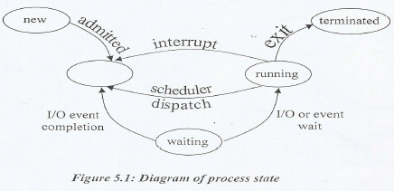
5.2 Process states

Slide 6
5.3 Process Control Block
Each process is represented in the 0/S by a Process Control Block (PCB)—also called a task control block. A PCB is shown in the following figures.
It contains many pieces of information associated with a specific process including these:
• Process state: It may be new, ready, running, waiting, halted and so on.
• Program counter: The address of the next instruction to be executed for this process.

Slide 7
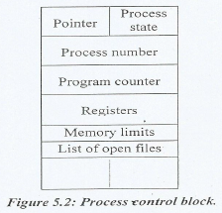
5.3 Process Control Block
CPU registers:
They include accumulators, index registers, stack pointers, and any general—purpose registers plus and condition—code information.
• CPU scheduling Information:
It Includes a process priority, pointers to scheduling queues.
• Memory Information management:
It nay include the value of the base and limit registers, the page tables... etc.
• Accounting information:
It includes the amount of CPU and real time used, time limits, account numbers, job or process numbers, and so on.
• I/0 status information:
It includes the list of I/O devices allocated to this process, a list of open files, and so on.
The PCB simply serves as the repository for any information that may vary from process to process.

Slide 8
5.4 Process Scheduling
The objective of multi programming is to have some process running at all times to maximize CPU utilization. The objective of time—sharing system is to switch the CPU among processes so frequently that users can interact with each program while it is running.
For the uni processor system there will never be more than one running process. If there arc more processes the rest will have to wait until the CPU is free

Slide 9
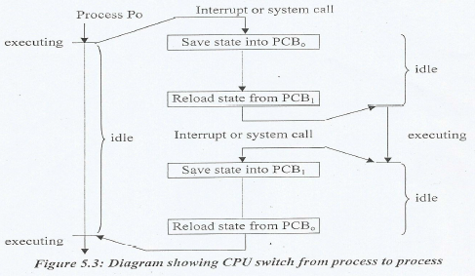
5.4 Process Scheduling

Slide 10
5.5 Scheduling Queue
As processes enter the system, they are put into a job queue. This queue consists of all processes in the system.
- The processes that are residing in memory and are ready and waiting to ' execute are kept on a list called the Ready queue.
- The queue is generally stored as a linked list the queue header contains pointers to the first and last PCB's in that list. Each PCB has a pointer field that points to the next process in the queue.
- There are also other queues in the system, such as a list of processes waiting for a particular I/O device is called a device queue.

Slide 11
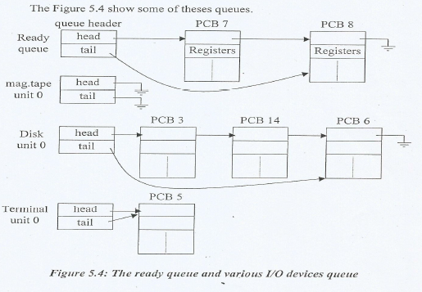
5.5 Scheduling Queue

Slide 12
5.5 Scheduling Queue
- A new process is initially put in the ready queue waits until it is selected for execution (or dispatched) and is given the CPU.
- Once the process is allocated the CPU and is executing one of several events could occur:
a. The process could issue an I/O request and then be placed in an I/O queue.
b. The process could create a new sub—process and wait for its termination.
c. The process could be removed forcibly from the CPU as a result of an interrupt and be put back in the ready queue.
The first two cases the process switches from the waiting state (queue) and is then put back in the ready queue. A process continue this cycle until its terminates at which time it is removed from all queues and has its PCB and resources deal located.
Figure 5.5 shows the process scheduling.

Slide 13
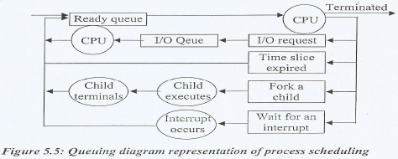
5.5 Scheduling Queue

